Slide 1
Advance Algorithm Unit-1 Introduction State Institute of Engineering & Technology Nilokheri,132117 Department: Computer Engineering

Slide 2
Algorithm and its Complexity

Slide 3
Data structure and Algorithm are foundation of computer programming. Algorithmic thinking, problem solving and data structures are vital for software engineers. Computational complexity is important for algorithm design and efficient programming.

Slide 4
Data structures and Algorithms are the fundamentals of programming. In order to become a good developer it is essential to master the basic data structures and algorithms and learn to apply them in the right way.

Slide 5
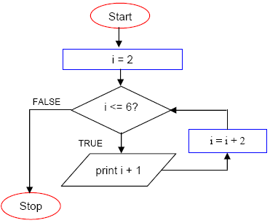
WHAT IS AN ALGORITHM?
An algorithm is a finite set of instructions or logic, written in order, to accomplish a certain predefined task. Algorithm is not the complete code or program, it is just the core logic(solution) of a problem, which can be expressed either as an informal high level description as pseudocode or using a flowchart.

Slide 6
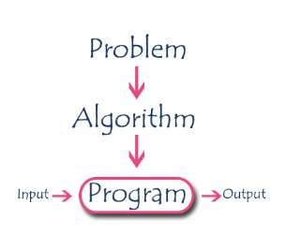
Algorithm Specifications
Every algorithm must satisfy the following specifications...
Input - every algorithm must take zero or more number of input values from external.
Output - every algorithm must produce an output as result.
Definiteness - every statement/instruction in an algorithm must be clear and unambiguous (only one interpretation)
Finiteness - for all different cases, the algorithm must produce
Result within a finite number of steps.
Effectiveness - every instruction must be basic enough to be carried out and it also must be feasible.

Slide 7
Performance Analysis
What is Performance Analysis of an algorithm?
Performance of an algorithm is a process of making evaluative judgement about algorithms.
Performance of an algorithm means predicting the resources which are required to an algorithm to perform its task.

Slide 8
An algorithm is said to be efficient and fast, if it takes less time to execute and consumes less memory space. The performance of an algorithm is measured on the basis of following properties :
Space Complexity
Time Complexity

Slide 9
Space Complexity
Its the amount of memory space required by the algorithm, during the course of its execution. Space complexity must be taken seriously for multi-user systems and in situations where limited memory is available.
An algorithm generally requires space for following components :
Instruction Space : Its the space required to store the executable version of the program. This space is fixed, but varies depending upon the number of lines of code in the program.
Data Space : Its the space required to store all the constants and variables value.
Environment Space : Its the space required to store the environment information needed to resume the suspended function.

Slide 10
Constant Space Complexity
int square(int a)
{
return a*a;
}
If any algorithm requires a fixed amount of space for all input values then that space complexity is said to be Constant Space Complexity.

Slide 11
Linear Space Complexity
int sum(int A[], int n)
{
int sum = 0, i;
for(i = 0; i < n; i++) sum = sum + A[i];
return sum;
}
If the amount of space required by an algorithm is increased with the increase of input value, then that space complexity is said to be Linear Space Complexity

Slide 12
Time Complexity
The time complexity of an algorithm is the total amount of time required by an algorithm to complete its execution.
If any program requires fixed amount of time for all input values then its time complexity is said to be Constant Time Complexity
int sum(int a, int b)
{
return a+b;
}

Slide 13
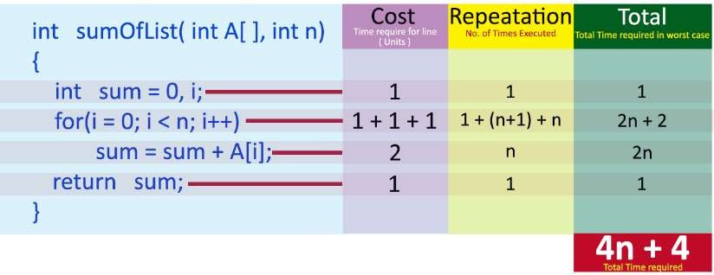
Linear Time Complexity
If the amount of time required by an algorithm is increased with the increase of
input value then that time complexity is said to be Linear Time Complexity
int sum(int A[], int n)
{
int sum = 0, i;
for(i = 0; i < n; i++) sum = sum + A[i];
return sum;
}

Slide 14
Asymptotic Notation
Asymptotic notation of an algorithm is a mathematical representation of its complexity
Majorly, we use THREE types of Asymptotic Notations and those are as follows...
Big - Oh (O)
Big Omega(Ω)
Big-Theta(Θ)

Slide 15
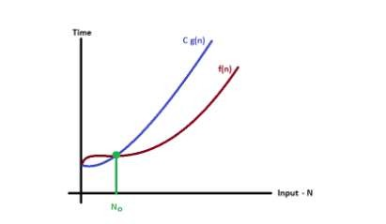
Big - Oh Notation (O)
Consider function f(n) the time complexity of an algorithm and g(n) is the most significant term. If f(n) <= C g(n) for all n >= n0, C > 0 and n0 >= 1. Then we can represent f(n) as O(g(n)).
f(n) = O(g(n))

Slide 16
How To Calculate Time Complexity?
Now the most common metric for calculating time complexity is Big O notation. This removes all constant factors so that the running time can be estimated in relation
to N, as N approaches infinity. In general you can think of it like this :
statement;
Above we have a single statement. Its Time Complexity will be Constant. The
running time of the statement will not change in relation to N.

Slide 17
for(i=0; i < N; i++)
{
statement;
}
The time complexity for the above algorithm will be Linear. The running time of the loop is directly proportional to N. When N doubles, so does the running time.

Slide 18
for(i=0; i < N; i++)
{
for(j=0; j < N;j++)
{
statement;
}
}
This time, the time complexity for the above code will be Quadratic. The running time of the two loops is proportional to the square of N. When N doubles, the running time increases by N * N.

Slide 19
while(low <= high)
{
mid = (low + high) / 2;
if (target < list[mid]) high = mid - 1;
else if (target > list[mid]) low = mid + 1;
else break;
}
This is an algorithm to break a set of numbers into halves, to search a particular field(we will study
this in detail later). Now, this algorithm will have a Logarithmic Time Complexity. The running time
of the algorithm is proportional to the number of times N can be divided by 2(N is high-low here).
This is because the algorithm divides the working area in half with each iteration.

Slide 20
void quicksort(int list[], int left, int right)
{
int pivot = partition(list, left, right); quicksort(list, left, pivot - 1); quicksort(list, pivot + 1, right);
}
Taking the previous algorithm forward, above we have a small logic of Quick Sort. Now in Quick Sort, we divide the list into halves every time, but we repeat the iteration N times(where N is the size of list). Hence time complexity will be N*log( N ). The running time consists of N loops (iterative or recursive) that are logarithmic, thus the algorithm is a combination of linear and logarithmic.

Slide 21
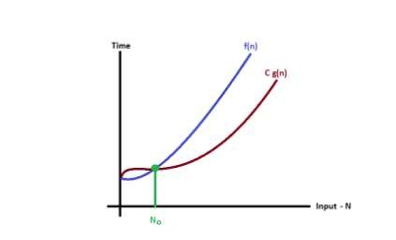
Big - Omege Notation (Ω)
Big - Omega notation is used to define the lower bound of an algorithm in terms of Time Complexity.
Consider function f(n) the time complexity of an algorithm and g(n) is the most significant term. If f(n) >= C x g(n) for all n >= n0, C > 0 and n0 >= 1. Then we can represent f(n) as Ω(g(n)).
f(n) = Ω(g(n))

Slide 22
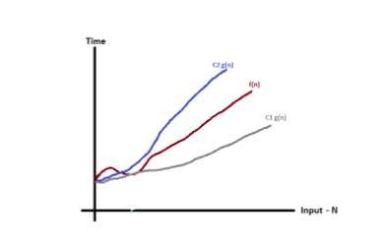
Big - Theta Notation (Θ)
Big - Theta notation is used to define the average bound of an algorithm in terms of
Time Complexity.
Consider function f(n) the time complexity of an algorithm and g(n) is the most significant term. If C1g(n) <= f(n) >= C2 g(n) for all n >= n0, C1, C2 > 0 and n0 >=
1. Then we can represent f(n) as Θ(g(n)).
f(n) = Θ(g(n))

Slide 23
NOTE : In general, doing something with every item in one dimension is linear, doing something with every item in two dimensions is quadratic, and dividing the working area in half is logarithmic.

Slide 24
Some Terminology For Binary Search Tree
The successor nodes of a node are called its children
The predecessor node of a node is called its parent
The "beginning" node is called the root (has no parent)
A node without children is called a leaf

Slide 25
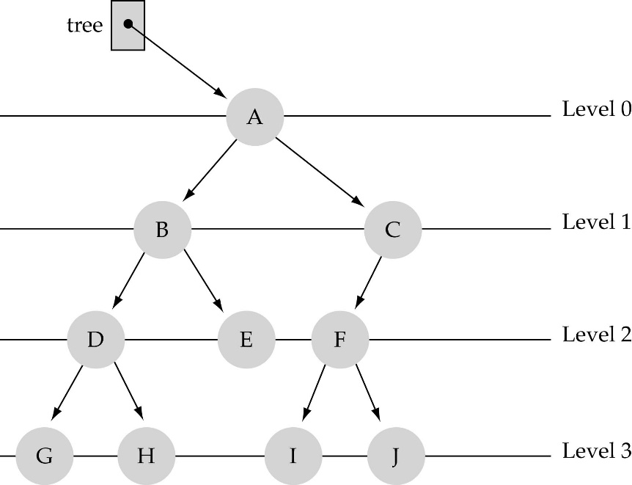
Some Terminology (Cont’d)
Nodes are organize in levels (indexed from 0).
Level (or depth) of a node: number of edges in the path from the root to that node.
Height of a tree h: #levels = l
(Warning: some books define h
as #levels-1).
Full tree: every node has exactly
two children and all the
leaves are on the same level.
not full!

Slide 26
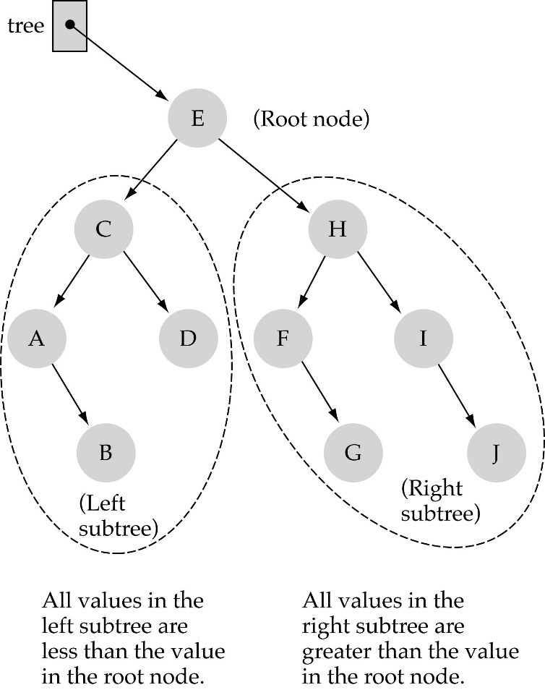
Binary Search Trees (BSTS)
Binary search tree property:
the value stored at a node is greater than the value stored at its
left child and less than the value stored at its right child.

Slide 27
Inorder
Visit second
tree
‘J’
‘E’
‘T’
‘A’
‘H’
‘M’
‘Y’
Visit left subtree first
Visit right subtree last

Slide 28
Preorder
Visit first
tree
‘J’
‘E’
‘T’
‘A’
‘H’
‘M’
‘Y’
Visit left subtree second
Visit right subtree last

Slide 29
Postorder
Visit last
tree
‘J’
‘E’
‘T’
‘A’
‘H’
‘M’
‘Y’
Visit left subtree first
Visit right subtree second

Slide 30
Recurrence Relations
A recurrence relation for the sequence {a_{n}} is an equation that expresses a_{n} is terms of one or more of the previous terms of the sequence, namely, a₀, a₁, …, a_{n-1}, for all integers n with n ≥ n₀, where n₀ is a nonnegative integer.
A sequence is called a solution of a recurrence relation if it terms satisfy the recurrence relation.

Slide 31
Substitution method
The most general method:
Guess the form of the solution.
Verify by induction.
Solve for constants.
Example: T(n) = 4T(n/2) + 100n
[Assume that T(1) = Θ(1).]
Guess O(n³) . (Prove O and Ω separately.)
Assume that T(k) ≤ ck³ for k < n .
Prove T(n) ≤ cn³ by induction.

Slide 32
Example Of Substitution
T
(
n
)
=
4
T
(
n
/
2
)
+
100n
≤
4
c
(
n
/
2
)
3
+
100n
=
(
c
/
2
)
n
3
+
100n
=
cn
3
−
((
c
/
2
)
n
3
−
100n
)
desired – residual
≤
cn
3
desired
whenever (c/2)n³ – 100n ≥ 0, for example, if c ≥ 200 and n ≥ 1.
residual

Slide 33
Recursion-tree method
A recursion tree models the costs (time) of a recursive execution of an algorithm.
The recursion tree method is good for generating guesses for the substitution method.
The recursion-tree method can be unreliable, just like any method that uses ellipses (…).
The recursion-tree method promotes intuition, however.

Slide 34
Example Of Recursion Tree
Solve T(n) = T(n/4) + T(n/2) + n²:
n²
(n/4)²
(n/2)²
(n/16)²
(n/8)²
(n/8)²
(n/4)²
…
…
Θ(1)
Total =
= Θ(n²)
geometric series

Slide 35
The Master Method
The master method applies to recurrences of the form
T(n) = a T(n/b) + f (n) ,
where a ≥ 1, b > 1, and f is asymptotically positive.

Slide 36
Three Common Cases
f (n) = O(n^{logba – ε}) for some constant ε > 0.
f (n) grows polynomially slower than n^{logba} (by an n^{ε} factor).
Solution: T(n) = Θ(n^{logba}) .

Slide 37
f (n) = Θ(n^{logba} lg^{k}n) for some constant k ≥ 0.
f (n) and n^{logba} grow at similar rates.
Solution: T(n) = Θ(n^{logba} lg^{k+1}n) .

Slide 38
f (n) = Ω(n^{logba + ε}) for some constant ε > 0.
f (n) grows polynomially faster than n^{logba} (by an n^{ε} factor),
and f (n) satisfies the regularity condition that a f (n/b) ≤ c f (n) for some constant c < 1.
Solution: T(n) = Θ( f (n) ) .

Slide 39
Examples
Ex. T(n) = 4T(n/2) + n³
a = 4, b = 2 ⇒ n^{logba} = n²; f (n) = n³.
CASE 3: f (n) = W(n^{2 + e}) for e = 1
and 4(cn/2)³ £ cn³ (reg. cond.) for c = 1/2.
∴ T(n) = Q(n³).
Ex. T(n) = 4T(n/2) + n²/lg n
a = 4, b = 2 ⇒ n^{logba} = n²; f (n) = n²/lg n.
Master method does not apply. In particular, for every constant e > 0, we have n^{e} = w(lg n).

